Slide 1






PowerShell Conference Asia
Automated DC Deployment with DSC at BMW
Raimund Andrée
Jan-Hendrik Peters

Slide 2
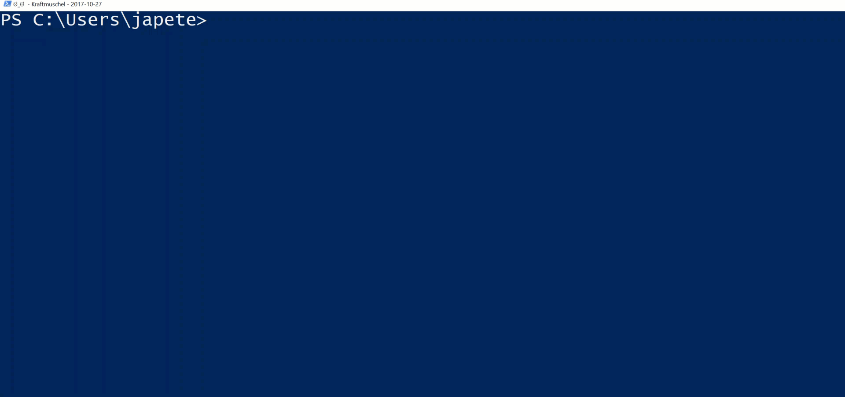

Introduction
PowerShell Conference
Singapore 2017

Slide 3
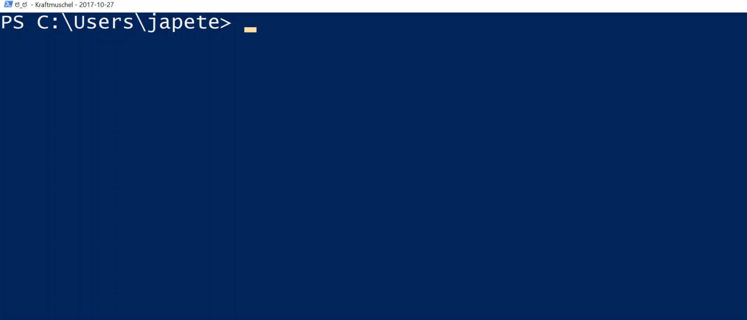
Introduction
PowerShell Conference
Singapore 2017

Slide 4
Agenda
Introduction
Using DSC at the BMW group
The theory
The obstacles
The solutions
The takeaways
Rapid and automated lab deployment
PowerShell Conference
Singapore 2017

Slide 5
Desired State Configuration
Infrastructure as code™
MOF-based open standard
Ideal for DevOps
Idempotent
Applied automatically – same results always
Unwanted changes are reverted
Reportable
Compliance status across large infrastructure
Shared Code
Resources on GitHub
Quality checks and tests enforced
PowerShell Conference
Singapore 2017

Slide 6

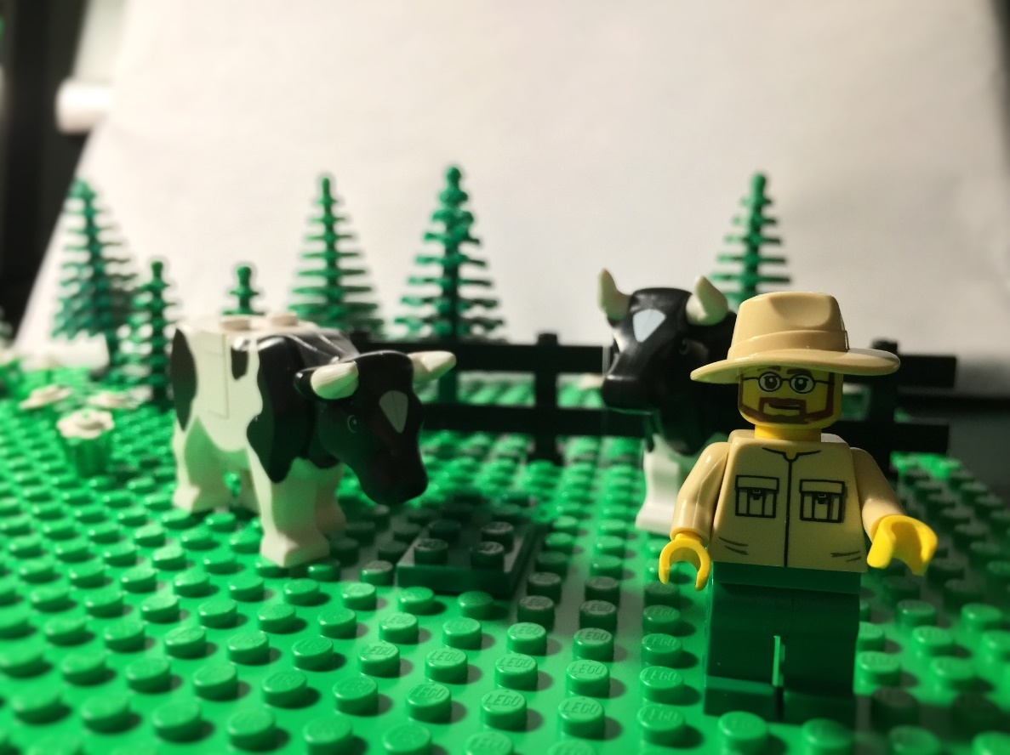
IaC best practices
Treat your infrastructure like “cattle”,
…not “pets”
PowerShell Conference
Singapore 2017

Slide 7
Desired State Configuration
Push or pull mode
Actively push a configuration
Let clients pull configuration data
Configuration enacted locally on each node
Configuration drift is prevented
Changes are reverted
PowerShell Conference
Singapore 2017

Slide 8

Case Study BMW Group

Slide 9
BMW Group
Domain controllers are created manually
A long list of instructions needs to be followed
Several historically grown scripts need to be executed
Configuration drift on domain controllers
Over time
DCs distributed throughout the world
Missing compliance reporting
Like many other companies little to no asset compliance reporting
PowerShell Conference
Singapore 2017

Slide 10
The theory
Replace the setup and installation manual with DSC configurations
Cover as much as possible, exclude legacy technology like WINS
Leverage publicly available code
DSC resources on GitHub are covering most standard tasks
Extend the DSC resources on GitHub instead of writing closed solutions
Solving 3 issues with one approach
Automated deployment (IaC)
Configuration Drift
Compliance Reporting
PowerShell Conference
Singapore 2017

Slide 11
Reality – The obstacles
Almost every domain controller has a different config
Writing DSC configs by hand is not an option
Contradicts the common assumption of DSC
Getting a development environment ready
At least 15 machines with AD, SQL, PKI, Pull Server
For load testing 8 + ~100 (very important task!)
DSC is not a ready-to-use solution (good and bad)
Most of the requirements could not be handled with DSC OOB
PowerShell Conference
Singapore 2017

Slide 12
Reality – The obstacles
“Uncommon” resources not actively developed
xStorage: Partition resize not possible
xActiveDirectory: DCPromo with IFM file not possible
xScheduledTask: Several shortcomings
…
Adoption of DSC still fairly low
Issues without troubleshooting info occur from time to time
Not enough documentation on e.g. scalable node status reporting
PowerShell Conference
Singapore 2017

Slide 13
Theory to Reality
Almost every domain controller has a different config
Moving configuration data into easily manageable files (txt, csv, xml, SQL)
Building a solution to translate the configuration data into DSC configs (hash tables, PSObjects)
Automating the development environment deployment
AutomatedLab for rapid, scalable and extensible development environment deployments
There is a dedicated session on this topic
DSC is not a ready-to-use solution (good and bad)
Build your framework around DSC or use ours
PowerShell Conference
Singapore 2017

Slide 14
DEMO
Raimund: Assembling ConfigurationData
Jan: Authoring the configuration
Raimund: Setting up the LCM
PowerShell Conference
Singapore 2017

Slide 15
DEMO
How to define a lab matching the your productive environment
Framework: AutomatedLab
For BMW Group, the test scenario is: 3 Domains with 1 domain controller each
1 CA, 1 SQL Sever 2016, 1 Pull Server
8 (or n) unconfigured VMs to test the domain controller setup
PowerShell Conference
Singapore 2017

Slide 16
Node Status Reporting
There is no official best practice for now
EDB (default database)
Locked
Hard to interact
MDB
max file size of 2GB
Using MDB as a proxy to SQL 2016
“Very easy” to retrieve data
SQL 2016 native JSON support
SQL Server Reporting Services
PowerShell Conference
Singapore 2017

Slide 17
DEMO
Using SSRS to visualize the overall DSC state
PowerShell Conference
Singapore 2017

Slide 18
Takeaway
DSC can deploy a highly complex domain setup
Solution with a high level of maturity
The community resources are required
DSC is a framework, not a inflexible solution
Use SQL Server 2016 (native JSON support incl. JSON indexes) for the database backend
Install your own lab: https://aka.ms/automatedlab
PowerShell Conference
Singapore 2017

Slide 19
Don’t Forget!
Fill in your survey in Mobile app – it’s how we do better!
Don’t lose you badge! You need it for the Social Events
Grab the Speakers for a chat – they all have time for you!
Let everyone know what they are missing on Social Media
#PowerShell
#PSConfAsia
Photos of Marina Bay Credit: Sebastian Szumigalski
PowerShell Conference
Singapore 2017

